Slide 1

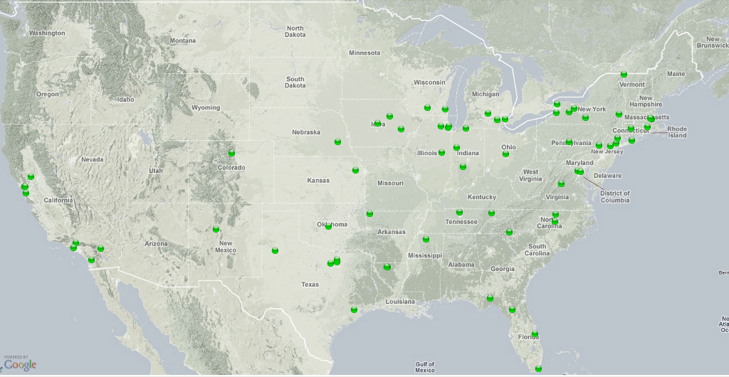
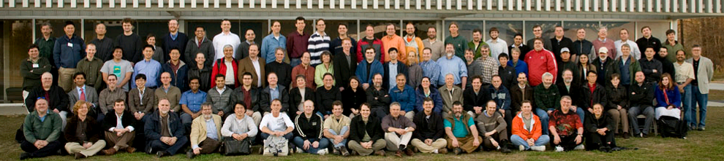


Collaborative Science,
Campus Cyberinfrastructure, & the Open Science Grid
Ruth Pordes
Fermilab

Slide 2
Outline
OSCER, Fermilab, OSG
Sharing of Software,Computing, Knowledge
Futures

Slide 3
Fermilab
  Open Science DOE Lab that supports world wide scientific collaborations of 1000s of physicists and a range of astrophysics, HEP, theory and accelerator science.
  Accelerators Detectors Data Analysis
  Energy Frontier Intensity Frontier Cosmic Frontier
Serves ~4,000 university users; internally ~200 in IT department: (Astro)Physicists, IT, Engineers, Computer & Computational Scientists. Participations in PhD programs in accelerator science; member of the DOE Computional Science Graduate Student Fellowship Program.

Slide 4
OSG
provides a cross-domain self-managed national distributed high-throughput computing facility…
that brings together campus and community infrastructures at all scales…
to provide services, support and facilitate the needs of scientific and research communities at all scales…
  Does not own processing, storage, networking hardware.
  Does not develop software.

Slide 5
Wide Area Science
Distributed Computing Social Network
A Consortium with more than 100 institutions of Scientists, IT and Software Providers.
A 5 year funded project ($6M/yr) across NSF and DOE SciDAC-2 with staff at 16 institutions.
Staff provides all aspects of the core distributed facility: software, operations, user and administrator support, security, training, collaboration with peers.
Consortium members make significant contributions. Most active are Physics Collaborations: HEP, NP, LIGO, who are prepared to collaborate with and support other programs and disciplines.
Active partnerships with European projects, ESNET, Internet2, Condor, Globus…

Slide 6





Virtual Organizations
OSG works with Virtual Organizations or Communities
There are 30 VOs in OSG spanning scientific, regional, campus, international and education,
There are specific “OSG owned VOs” to accommodate individual users

Slide 7
Map of Accessible Resources
Why User map not yet feasible.

Slide 8
The Distributed Computing Model
Open
Science
Grid
Fermilab
OSCER
Federated Autonomous CyberInfrastructures

Slide 9
National
Cyber-
Infrastructure
Part of World-Wide
Infrastructure
Campus Grid &
Large Scale Science
Community Grids &
DOE Lab IT Facility
Faculty, Cross-Campus &
Regional Grids
Students, Educators,
Researchers, CS…

Slide 10
Several Current Models for Campus Grids (in OSG)

Slide 11
A Campus Condor pool with no OSG connectivity e.g University of North Carolina,
Department
HPC
Workstation
Central Manager
Lab/Library
Department
Department
Department
Workstation
Notes:
Central IT dedicated resources, computer labs, libraries, departmental compute resources, computers in research labs, grad student work stations, …

Slide 12
FermiGrid : Cross Campus sharing with Each Cluster a Node on the Wide Area Grid
User Login
& Job
Submission
OSG
TeraGrid
FermiGrid
Authentication/Authorization
Services
FermiGrid
Monitoring/
Accounting
Services
FermiGrid
Site
Gateway
FermiGrid
Infrastructure
Services
General
Purpose Grid
1117 batch
slots
D0
Grid
5189 batch
slots
CDF
Grid
5472 batch
slots
CMS
Grid
5540 batch
slots
Total batch slots: 17,318

Slide 13
Cross Campus sharing with Each Cluster also a Node on the Wide Area Grid
User Login
& Job
Submission
OSG
TeraGrid
FermiGrid
Authentication/Authorization
Services
FermiGrid
Monitoring/
Accounting
Services
FermiGrid
Site
Gateway
FermiGrid
Infrastructure
Services
General
Purpose Grid
1117 batch
slots
D0
Grid
5189 batch
slots
CDF
Grid
5472 batch
slots
CMS
Grid
5540 batch
slots
Total batch slots: 17,318

Slide 14
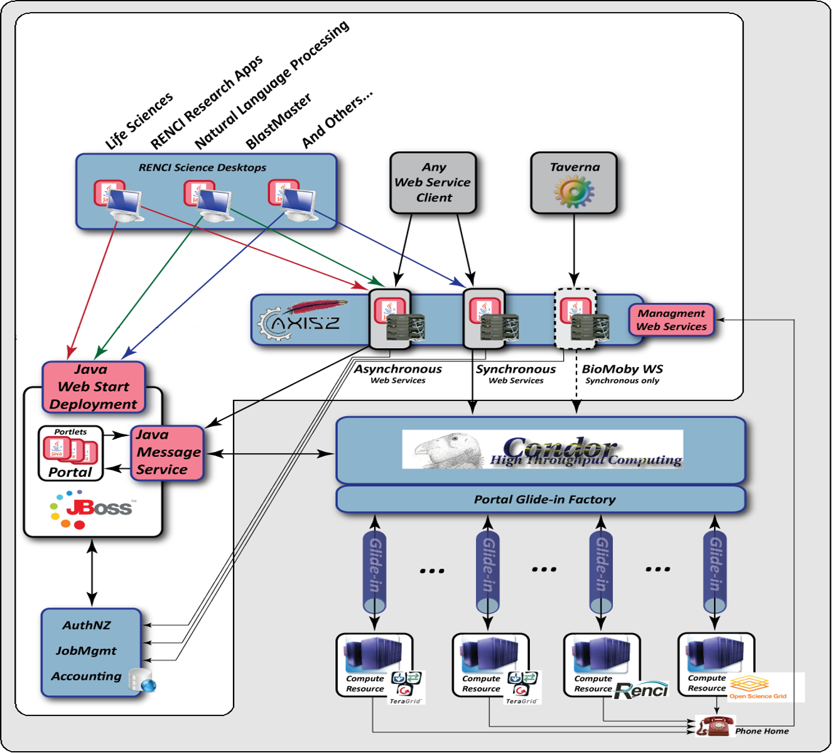
University of North Carolina

Slide 15
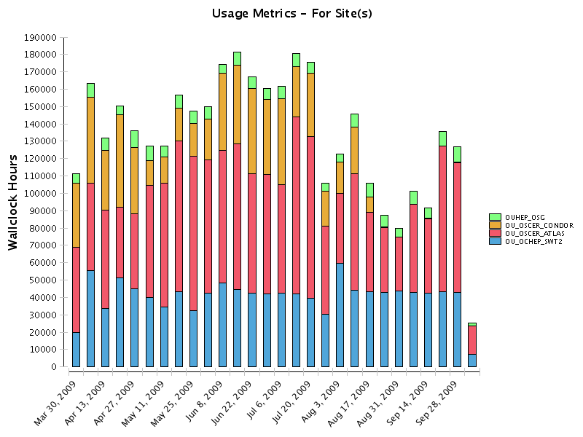
OSCER
A “mix” several clusters as one Condor Pool, with several “gateways” to the Wide Area Grid.
Averaging ~100 CPUhours/hour for OSG use – sharing unused local compute cycles

Slide 16
OSG Helps
University researchers, faculty and students to interact with “national CI” including TeraGrid, OSG, other Regional grids etc.
Organize the campuses to change their culture and Share Resources locally.
Enable campuses and users to send jobs and data “on-demand” between the local and remote facilities, becoming full members of the nation-wide shared cyber-infrastructure.

Slide 17
National
Cyber-
Infrastructure
Part of World-Wide
Infrastructure
Campus Grid &
Large Scale Science
Community Grids &
DOE Lab IT Facility
Faculty, Cross-Campus &
Regional Grid
Students, Educators,
Researchers, CS…

Slide 18
National
Cyber-
Infrastructure
Part of World-Wide
Infrastructure
Campus Grid &
Large Scale Science
Community Grids &
DOE Lab IT Facility
Faculty, Cross-Campus &
Regional Grid
Students, Educators,
Researchers, CS…

Slide 19
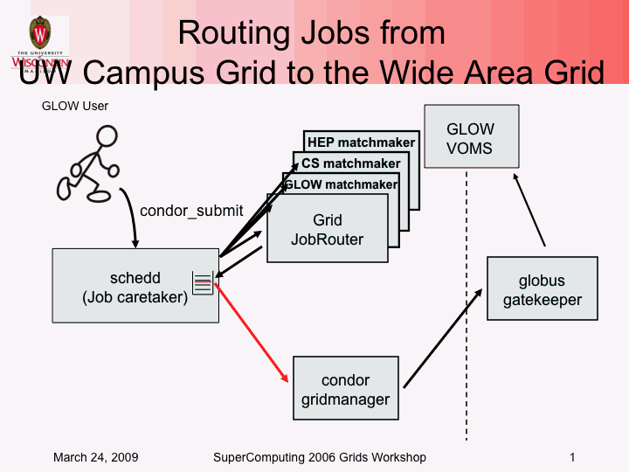
Condor job router – Grid Laboratory of Wisconsin
Automated way to let jobs run on a wider array of resources
  Transform jobs into different forms
  Reroute jobs to different destinations
  Handle security
Notes:
In short the key functionality is the fact that Condor can submit to ARC, and that the WMS, using Condor, is capable of parsing ARC-CE contactstrings in the BDII.
Hence, the only thing needed is to publish the ARC-CE in the BDII (which is already a feature of the ARC-CE - so no translator needed), and to install the glite-WN environment on the worker nodes - thats it, then the ARC-CE will start to receive gLite-jobs, as if it was a CREAM or LCG CE.
Arc CE then dispatches the glite jobs managing the queues and the data transfer

Slide 20




Glide-ins at RENCI
Temporarily join remote machines
into local Condor pool
TeraGrid Resources
OSG Resources
NIH Resources
Condor
Pool
RENCI Resources

Slide 21
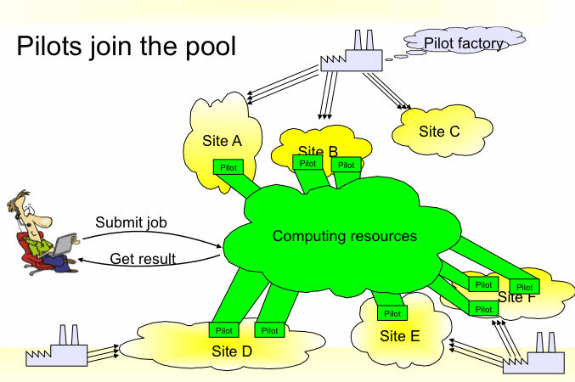
Overlaid Workspaces
Deploy “agents” on each site which learn about the local environment and communicate with user portal to most efficiently get requests done.
Each of the LHC Experiments has done this (differently)

Slide 22
Open
Science
Grid
Fermilab
OSCER
Tevatron Physics
LHC Physics
Support for Science locally and broadly

Slide 23
Tevatron Physics
OU is a DZero Collaborator & important part of the Dzero Community SAMGrid, hosting data serving and catalog services.
CDF and D0 Experiments profit from LHC resources through adapting to and using OSG. Interesting issue how to “quantify” the value gained.
Brazilian institutions are important partners for both Fermilab and OSCER/DO.

Slide 24
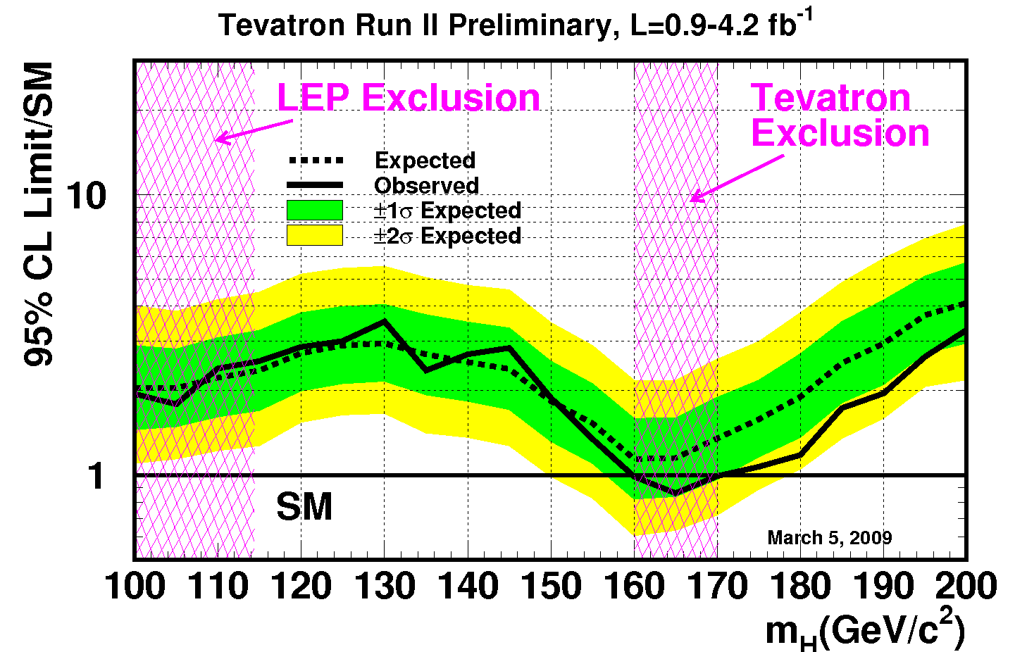
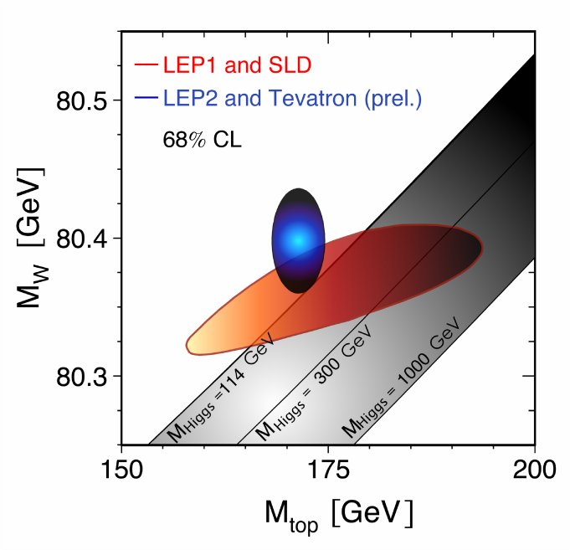
RESULTS from
Supporting the Search for the Origin of Mass
Shrunk the Higgs mass window from a few hundred GeV to ~ 40 GeV. Thus providing a 135GeV +- 15% target region for future discoveries.
(press release March 2009).
Direct Higgs Search at Tevatron
now excluding high mass higgs.
Top and W masses now known to
0.3% and 0.75% respectively.
=> Constrain Higgs via Quantum effects.

Slide 25
US LHC Physics
OU is US ATLAS Tier-2 site.
Fermilab is US CMS Tier-1.
OSG Contributes to WorldWide LHC Computing Grid by supporting US ATLAS and US CMS.
South/Central American institutions important collaborators for experiments and OSG.

Slide 26
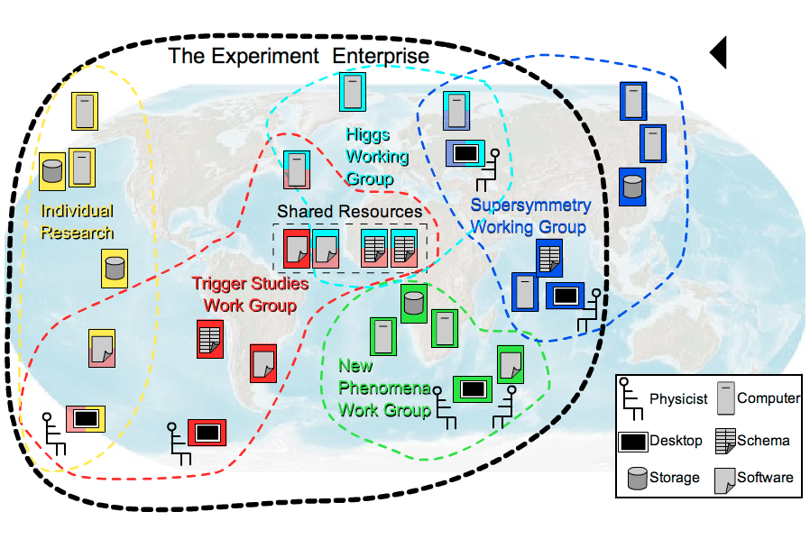
The LHC: WorldWide Community Overlays on Shared Facilities (circa 2005 & still true today)
Our Original Vision
Notes:
redraw this to show better overlap and definition of different kinds of communities

Slide 27
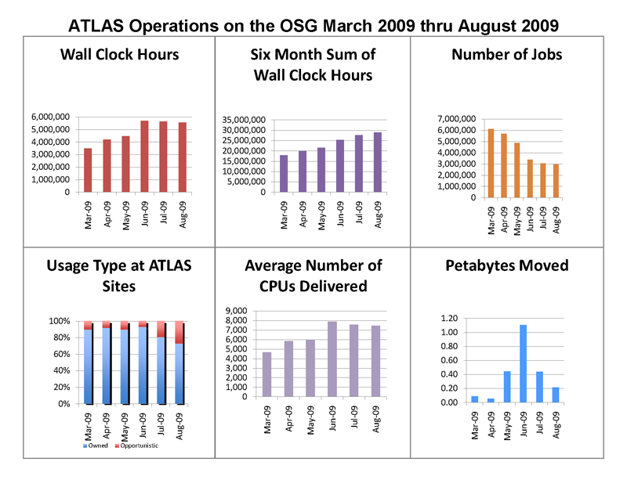
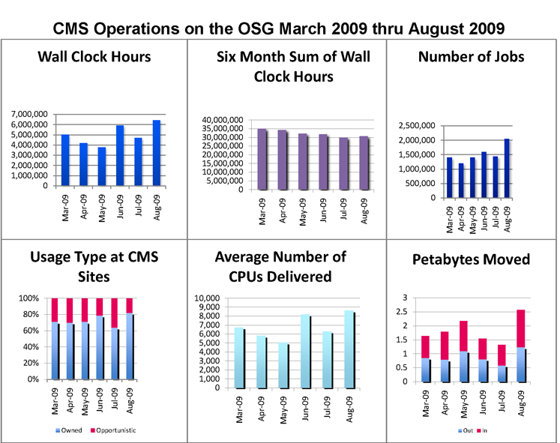
Scale of LHC Usage in US
Implies ~
300,000 jobs a day
3 TeraBytes moved each hour
Across 3 DOE labs,
15 large Universities,
10 smaller Universities

Slide 28
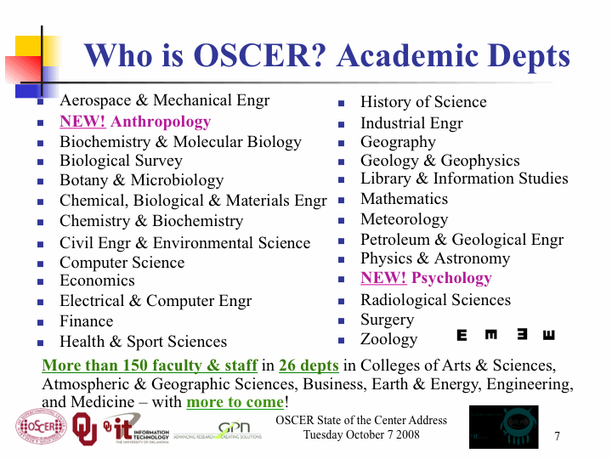

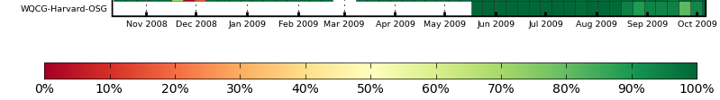
OSCER Contributes
User Communities
(from 2008 talk)
Computing Cycles
16,000 hrs/week; 600 hrs/hr
Sustained Reliability

Slide 29
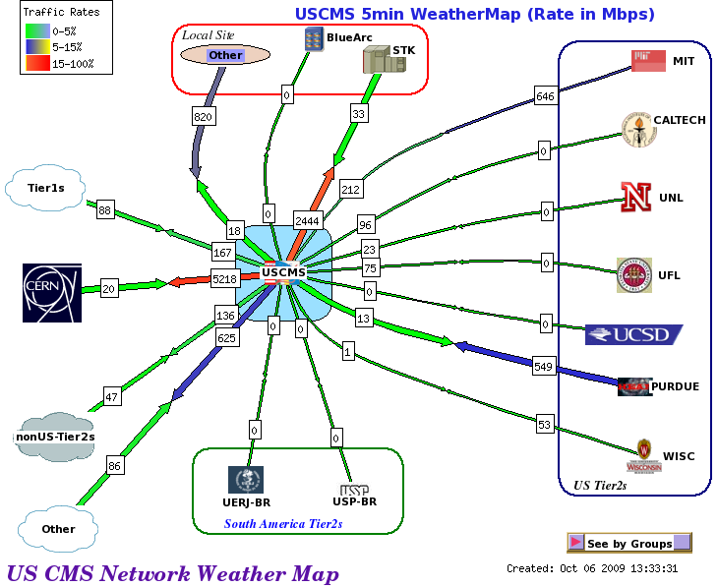
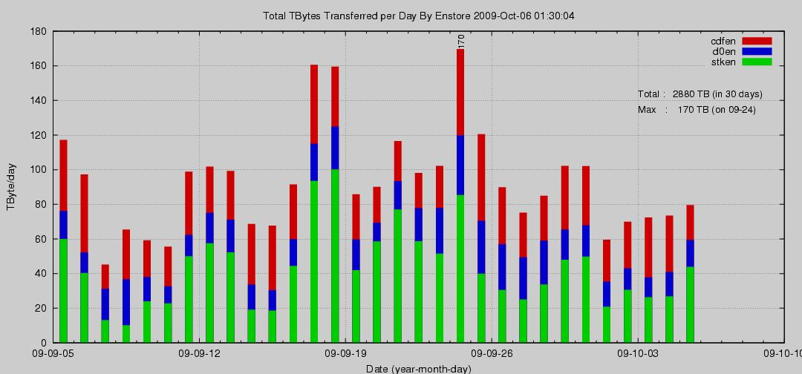
Fermilab brings Large Data Storage, Network and Data Movement expertise
  Data Input and Output Hub
  Large Daily I/O to/from Tape

Slide 30
Acting as an Agency
..supports and brokers relationships/expectations between user communities & resources, services, software.
Grid Services
OSG
Integrates, Tests, Operates, Troubleshoots,
Monitors, Manages, Supports

Slide 31
Some other users
Gravitational Wave: Einstein@Home, gradually progressing #2 in the world
Protein structure prediction: Toyota Institute.
Weather Research Forecasting: U. North Carolina, University of Nebraska.
Structural Biology Predictions: Harvard Medical School.
Nanotechnology Simulation and Modelling: Purdue University and Nanohub collaboration.
Molecular Dynamics: U of Buffalo, Argentina
Theoretical Nuclear Physics: Duke University..
Text Mining: U. North Carolina
Exploring Mathematical algorithms: University of Colorado

Slide 32
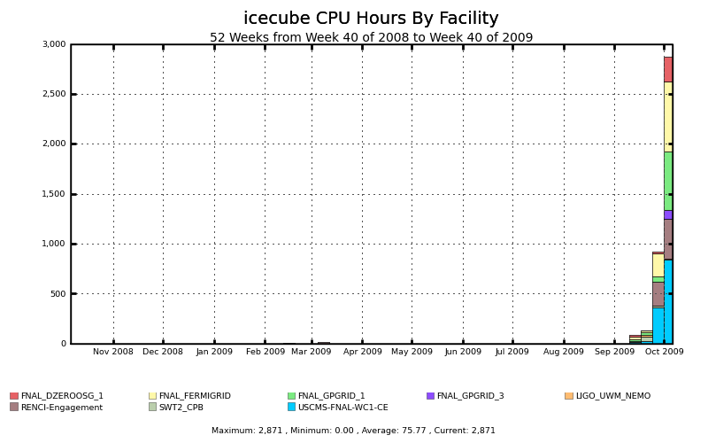
Once applications are adapted, communities ramp up to use multiple sites quickly
IceCube, a telescope under construction at the South Pole, will search for neutrinos from the most violent astrophysical sources: events like exploding stars, gamma ray bursts, and cataclysmic phenomena involving black holes and neutron stars.

Slide 33
Sharing of Software and Knowledge
Computing, data, storage rely on software to be useful.
OSG provides a common software set which is packaged, tested, distributed for many different OS and provided in different configurations for Users, Communities, Processing, Storage, and Data servers.
Software built and tested on ~15 Linux variants.
System testing done on separate test Grid with more than 15 sites and 10 science communities participating

Slide 34
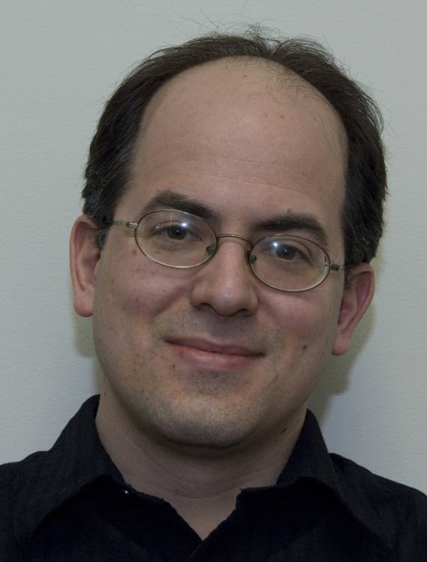

Alain Roy,
The software coordinator. He is a computer scientist in the Condor Project.
(He is a master bread maker)

Slide 35



Architectural Layers – whether Local or a Campus or Wide Area
e.g.
OSG
Users, User Applications,
Community Common Software and Support
Science, Research, Education, Training
Software, Services & People to help
(~60 modules in the Common Virtual Data Toolkit)
Processing, Storage, Data and Administrators,
(For OSG at ~75 US Labs and Universities)

Slide 36
Bridging software ensures Uniformity presented to the User across Multiple Software Implementations
Users, User Applications, Communities
Science, Research, Education, Training
Software Toolkit 1
Software Toolkit 2
Infrastructure A
Infrastructure B
Bridging Software

Slide 37
Software Components
Command Line User Interface
Security
Monito-ring, Error Reporting
Application Services
Inform-ation
Job Scheduling & Management
Data Handling & Management
Operating System

Slide 38
Why Depend on OSG for Software?
User communities have long term needs for distributed systems support and operations which can be supplied by dedicated organization.
Common software is more efficiently tested, packaged evolved, supported across multiple s/w developers and OS versions.
Change and evolution is managed by experts and knowledge is transferred more efficiently.

Slide 39
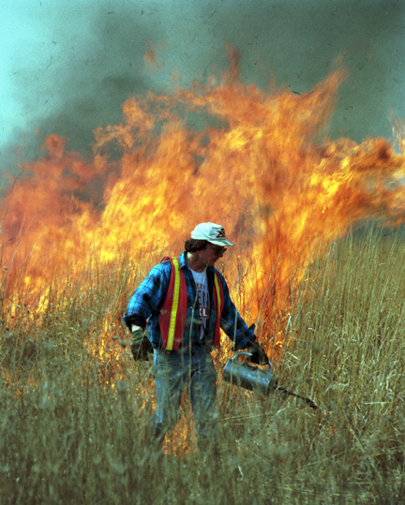
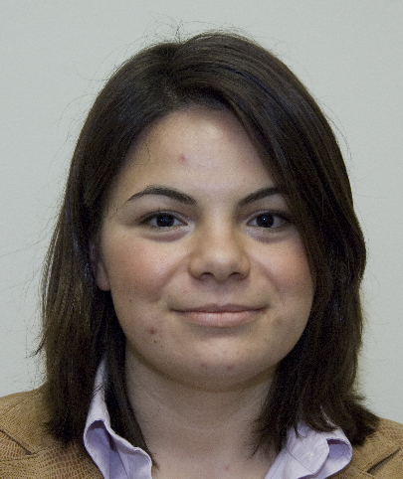
Central Security Organization helps part-time administrators, new recruits, and timely, consistnt broad response to incidents.
“Providing the security framework that promotes autonomous and open science collaboration…”
  Ensuring security is not compromised because of Open Science
  Ensuring science is not burdened because of security
Mine Altunay,
The OSG Security Officer. She is a Computer Scientist at Fermilab

Slide 40
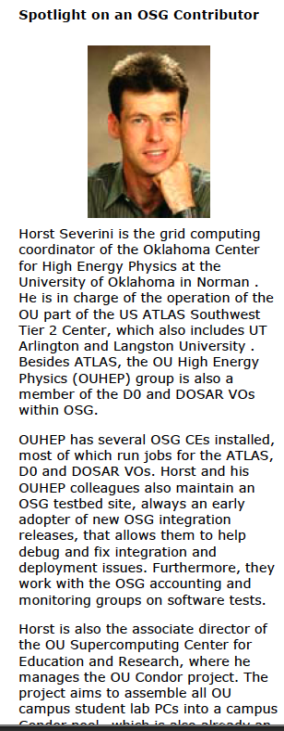
OU is an Early Member
Many contributions
  Exemplar Cross-Campus organization and sharing of computing.
  Testing of new versions of Software
  Allowing computing and caches to be used by many different communities
  Bringing new applications to the table locally and across DOSAR sites.
  Contributions to software including accounting, metrics
  Support for Sao Paolo regional grid.
Looking forward to more to come!
OSGNews
Nov 2006.

Slide 41
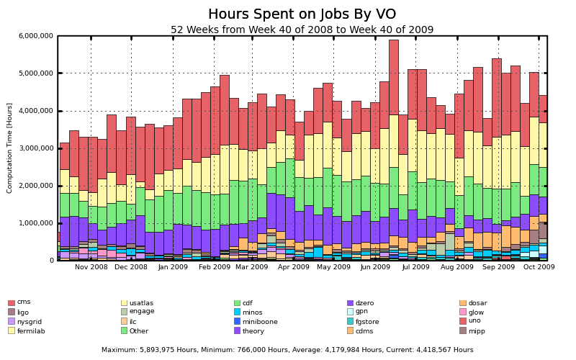
Support for Production Running
Across Independent Facilities for Independent User Communities relying on Production Software: Talk by Dan Fraser later today.

Slide 42
Knowledge Transfer: Other Campus-Regional Grids
Sao Paolo State Grid in Brazil – GridUNESP – now has 7 individual sites/cluster.
Organizationally intending to become Regional Grid
OU contributions to transfer knowledge, OSG services and software.
Another Autonomous Federated Infrastructure that will interface to and depend on some OSG, or OSG partner, help.

Slide 43
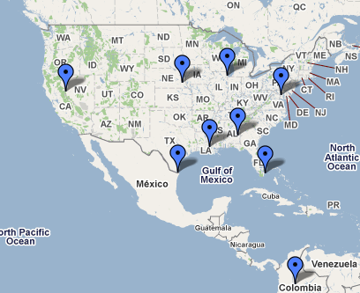
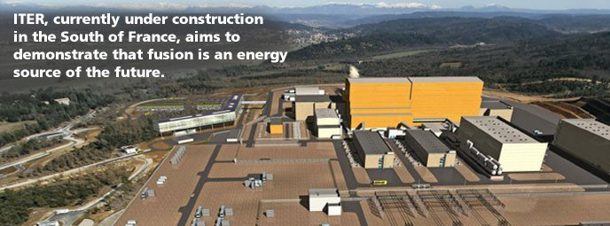
“viral” extension
Grid Schools and Training sessions give hands on training in technologies and use.
“Engagement” helps early adopters get successful runs.
Participate in SC and TeraGrid education workshops.
Extend software through working as part of research groups themselves.
Goal to integrate into OSG program of work and increase collaboration with others.

Slide 44
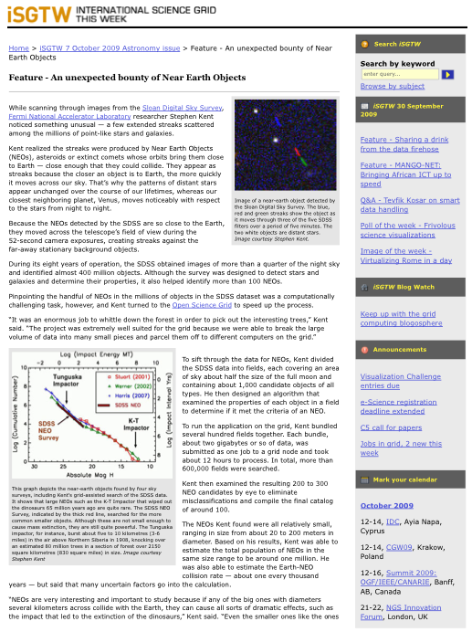
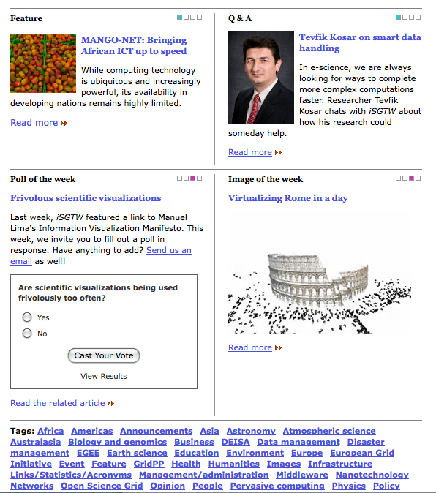
International Science Grid
This Week
Initiated by OSG, adopted by Europeans, now potentially to include TeraGrid.

Slide 45
Futures – Vision

Slide 46
Seeding Expansion in University Campus Grids
~100 US LHC Tier-3s will participate to get data through OSG and run jobs locally and remotely.
New Neescomm (Earthquake shake tables) Community Collaboration sub-committee. 14 equipment sites collect, archive and share data.
Internet2, Educause educate the CIOs, CFOs and Presidents through workshops and “CIDays”.
OSG to participate with TeraGrid Campus Champions.
….. Your ideas ??

Slide 47
The OSG & TeraGrid Mix
OSG and TeraGrid use same fundamental software.
  Client/user-side software should be easily adaptable to use both.
  Several portals access both (Nanohub, RENCI, GIGI)
To use TeraGrid you need to apply for and be granted an Allocation.
To use OSG you need to register with a Community or VO. OSG provides some “ready made” VOs:
  OSGEDU is a VO for Students and Teachers
  Engage is a VO where we help you get your code to run and then run “helper services” for you to monitor your runs, select sites where your code will run etc.

Slide 48
A National Vision
We (OSG) aim to be a driver for and
An integral part of the
National Cyber-Infrastructure
! With Continued Help and Involvement !

Slide 49
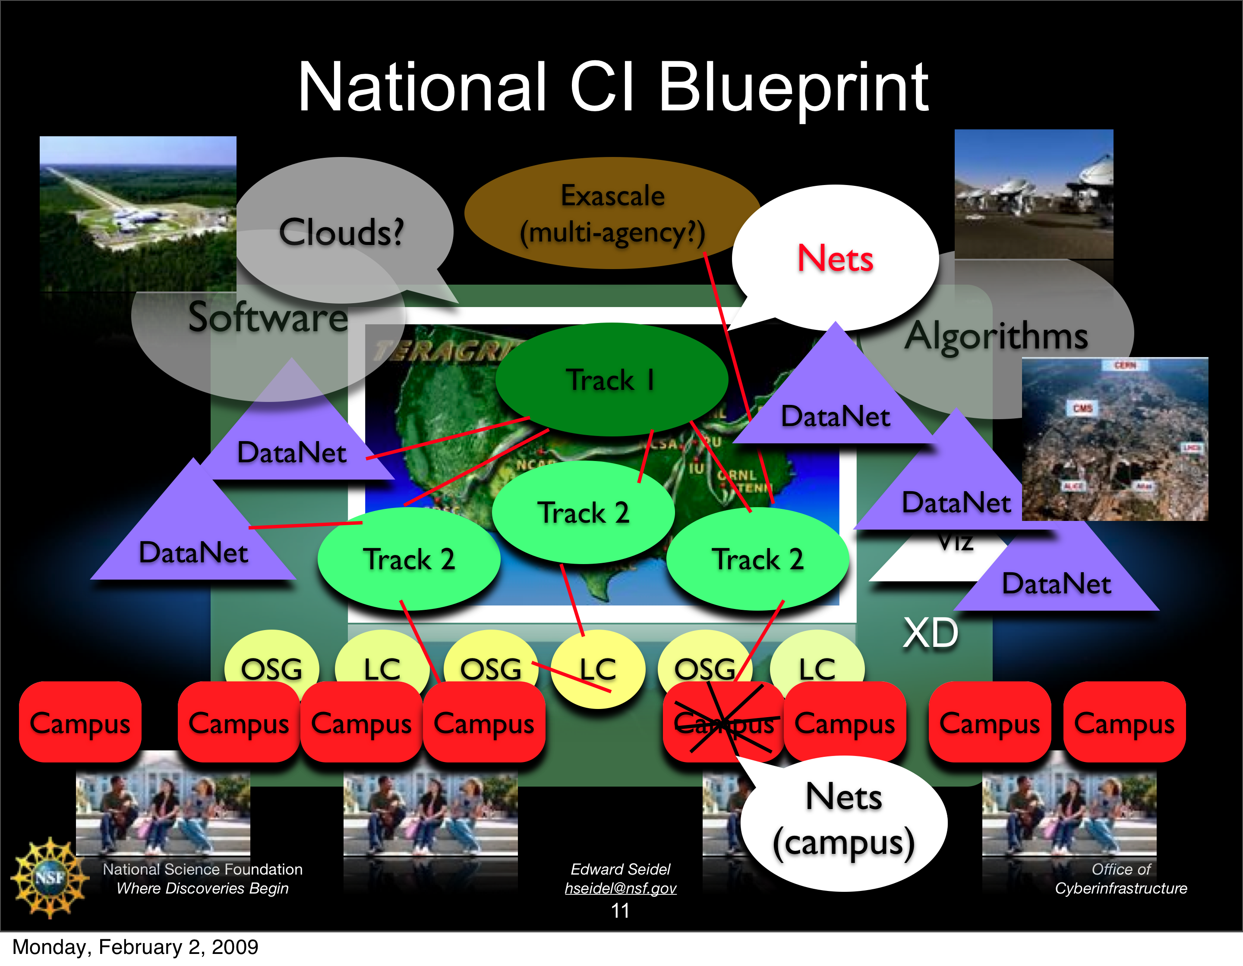
National Science Foundation Landscape
– Ed Seidel, Feb 2009

Slide 50
OSG looks at the Whole System
Collaboratory
Workflow

Slide 51
E.g. Smooth support for all scales of parallel jobs
New OSG satellite project to test small-scale parallel jobs that use multiple cores on one CPU-box.
Fills gap between single processor, high throughput, support from OSG and large MPI, high performance, from TeraGrid.
OSCER to be the first site used!
More OSG-TG Collaboration coming? Note words in TG extension project:
* Continue to support several resources into 2011. This includes the Track 2 systems, ….
* Allow high-throughput, Open Science Grid-style jobs.
* Enable exploration of interoperability and technology sharing.
* Provide a transition platform for users coming from university- or departmental-level resources.
* Support unique compute platforms and massive storage systems….

Slide 52
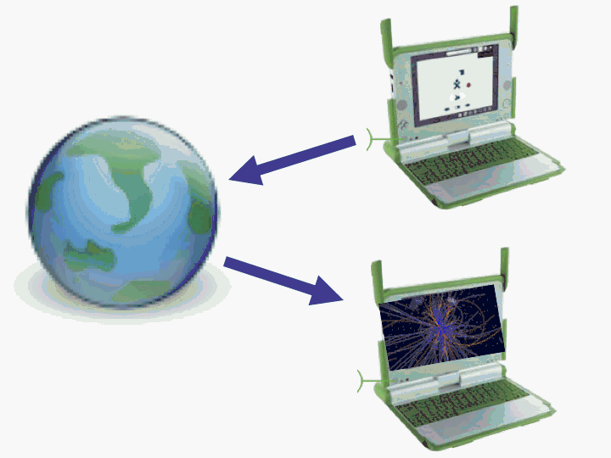
Provide software Glue for use of the full suite of computing resources out there
Integrate commercial Cloud computing –Amazon, Google etc.
“No campus left behind”.
Support Virtual Machines of various types.
Bringing in the next generaions.
Unique HPC & visualization engines.
Integrate the laptops,iphones..
Shared data repositories & large local data silos.
Data from multi-robots and distributed sensors.

